Slide 1
Local Search
Session 05
Henry Lucky, S.Kom., M.Kom.

Slide 2
Learning Outcomes
Session 5
At the end of this session, students will be able to:
LO 2: Apply various search algorithms for agents to solve problems

Slide 3
outline
Session 5
Introduction
Hill Climbing

Slide 4
Introduction
definition
In many optimization problems, the path to the goal is irrelevant; the goal state itself is the solution.
The idea: keep a single "current" state, try to improve it according to an objective function.
Local search algorithms:
  Use little memory
  Find reasonable solutions in large infinite spaces

Slide 5
Introduction
definition
Local search is applicable to issues that may be expressed as the search for a solution that maximizes a specific criterion from a set of potential solutions.
Local search algorithms iteratively explore the search space of potential solutions until an optimal solution is found or a time limit is reached.
A local search algorithm starts from a candidate solution and then iteratively moves to a neighbor solution.
Local search methods are generally considered incomplete as they may terminate even if the algorithm has not located the ideal solution.

Slide 6
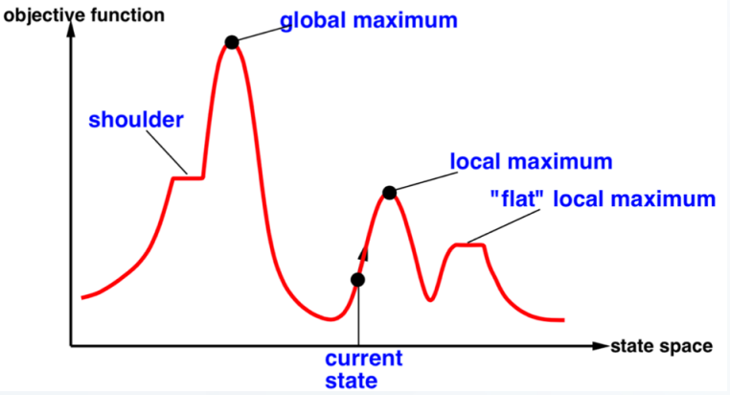
Introduction
definition
Search Landscape (2D)

Slide 7
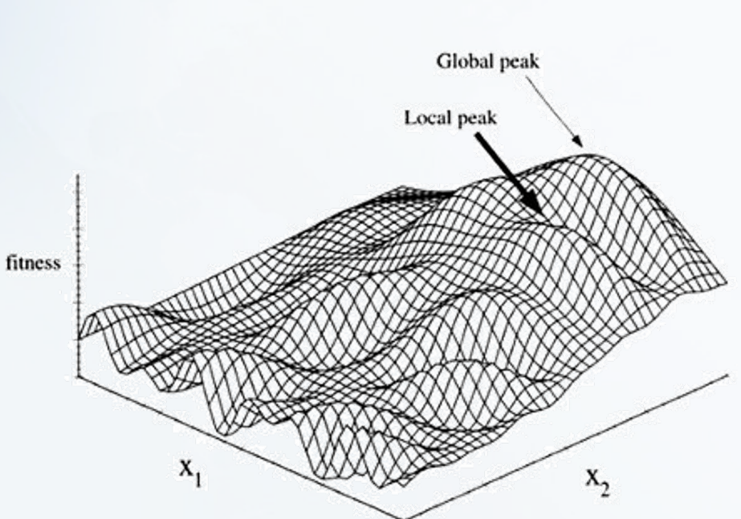
Introduction
definition
Search Landscape (3D)

Slide 8
Hill climbing search
definition
Continually moves in the direction of increasing value (i.e., uphill).
Terminates when it reaches a “peak”, no neighbor has a higher value.
Only records the state and its objective function value.
Does not look ahead beyond the immediate.
Sometimes is called Greedy Local Search
Problem: can get stuck in local maxima,
its success depends very much on the shape of the state-space land-scape: if there are few local maxima, random-restart hill climbing will find a “good” solution very quickly

Slide 9
Hill climbing search
example
Posters will be placed in Binus' IT-Math (M), IT-Stat (S), Computer Science (C), Data Science (DS) and Computer Engineer(E) departments.
The distance between locations is as follows:
 | M | C | DS | E | S
M | 0 | 0.9 | 0.6 | 0.8 | 0.7
C |  | 0 | 1.3 | 1.5 | 1.3
DS |  |  | 0 | 0.2 | 0.3
E |  |  |  | 0 | 0.2
S |  |  |  |  | 0
Find the installation path with the shortest distance
Value h = total distance

Slide 10
Hill climbing search
example
Initial State – (M -> E->C->S->DS) (path is randomly selected)
Value of h = 0.8 + 1.5 + 1.3 + 0.3 = 3.9
 | M | C | DS | E | S
M | 0 | 0.9 | 0.6 | 0.8 | 0.7
C |  | 0 | 1.3 | 1.5 | 1.3
DS |  |  | 0 | 0.2 | 0.3
E |  |  |  | 0 | 0.2
S |  |  |  |  | 0
The value of h is seen based on the distance between the current node and the next node

Slide 11
Hill climbing search
example
Next, we look for neighbors (other alternatives)
The way to generate neighbors is by using the swap process
Example of swap process: (A->B->C)
  Swap A-B to get (B->A->C)
  Swap A-C obtained (C->B->A)
  Swap B-C gets (A->C->B)

Slide 12
Hill climbing search
example
Neighbors are formed by swapping two locations:
  (E->M->C->S->DS) = 3.3
  (S->E->C->M->DS) = 3.2
  (M->C->E->S->DS) = 2.9
  (M->DS->C->S->E) = 3.4
  (M->E->DS->S->C) = 2.6
  (C->E->M->S->DS) = 3.3
  (DS->E->C->S->M) = 3.7
  (M->S->C->E->DS) = 3.7
  (M->E->S->C->DS) = 3.6
  (M->E->C->DS->S) = 3.9

Slide 13
Hill climbing search
example
Hill climbing will choose h= 2.6
  The current state (M->E->DS->S->C)
The swap process is performed 1 x again and the optimal solution is obtained:
  (S->E->DS->M->C) with h= 1.9

Slide 14
Case study
Poster placing
You are a campaign planner who wants to place posters in three cities: City A, City B, and City C. Your goal is to minimize the total distance traveled to put up these posters. You decide to use the hill climbing algorithm to find the most efficient order of poster placement.
Given the table of distance between cities below:
The initial path is A->B->C->D
 | A | B | C | D
A | 0 | 10 | 20 | 30
B |  | 0 | 15 | 25
C |  |  | 0 | 35
D |  |  |  | 0

Slide 15
References
Session 5
Russell, S. J., Norvig, P., Chang, M., Devlin, J., Dragan, A., Forsyth, D., Goodfellow, I., Malik, J., Mansinghka, V., Pearl, J., & Wooldridge, M. J. (2022). Artificial intelligence: A modern approach (Fourth edition, global edition). Pearson.
https://www.youtube.com/watch?v=RxQxFRUadvw
https://www.jarrar.info/courses/AI/Jarrar.LectureNotes.Ch4.LocalSearch.pdf

